Slide 1
PREDICTING FREQUENCY OF BLOOD TRANSFUSION IN SCD PATIENTS
ILAKUT EMMANUEL
KASULE JOHN TREVOR

Slide 2
INTRODUCTION
Sickle cell disease (SCD) is a group of inherited red blood cell disorders characterized by abnormal hemoglobin, called hemoglobin S or sickle hemoglobin, in the red blood cells. One of the most serious complications of SCD is anemia, a condition where the body does not have enough healthy red blood cells to carry adequate oxygen.
Sickle cell disease contributes substantially to mortality in children younger than 5 years in sub-Saharan Africa. In Uganda, 20 000 babies per year are thought to be born with sickle cell disease, but accurate data is not largely available.

Slide 3
LITERATURE REVIEW
Current Studies have focused on the prevalence of the sickle cell trait and disease and not on prediction of Frequency of blood transfusion requirements using technology. Sickle cell disease is less common in children older than 12 months or who were HIV positive,

Slide 4
BACKGROUND AND SIGNIFICANCE
Sickle cell disease (SCD) is a genetic blood disorder causing red blood cells to become misshapen and fragile. This abnormal shape can lead to severe anemia, characterized by a shortage of healthy red blood cells.
To manage this condition, many SCD patients rely on frequent blood transfusions to replace damaged cells and improve oxygen-carrying capacity.
The dataset for this project was obtained from the Haematology department of Le-Memorial Hospital in Entebbe.The data was collected from 100 SCD patients over a period of 3 years.This source is significant as it provides a direct insight into clinical parameters relevant to sickle cell disease (SCD) and its complications, particularly frequency of Blood transfusion

Slide 5
PROJECT SCOPE
Data Cleaning and Preprocessing:
Clean and Address missing values
Exploratory Data Analysis (EDA):
Conduct an in-depth analysis of the dataset to visualise and summarise key variables related to frequency of blood transfusion, including frequency of anaemia
Statistical Analysis:
Utilise statistical techniques to identify correlations between frequency of blood transfusion and Age, Gender, Temperature
Machine Learning Models:
Implement predictive models to assess the impact of various features on frequency of blood transfusion models such as logistic regression, decision trees, and linear regression.
Gaps in Current Literature: Identify missing Gaps in existing research

Slide 6
PROBLEM STATEMENT
Sickle cell disease (SCD) leads to abnormal red blood cells that break down rapidly. This can cause severe anemia, requiring frequent blood transfusions.

Slide 7
RESEARCH QUESTIONS
How do frequency of anemia, vital score affect transfusion needs?
Are there sex-based differences in transfusion needs?
How do fluctuations in hemoglobin levels correlate with transfusion needs?
Are there associations between white blood cell counts(Packet Cell Volume) and transfusion requirements?

Slide 8
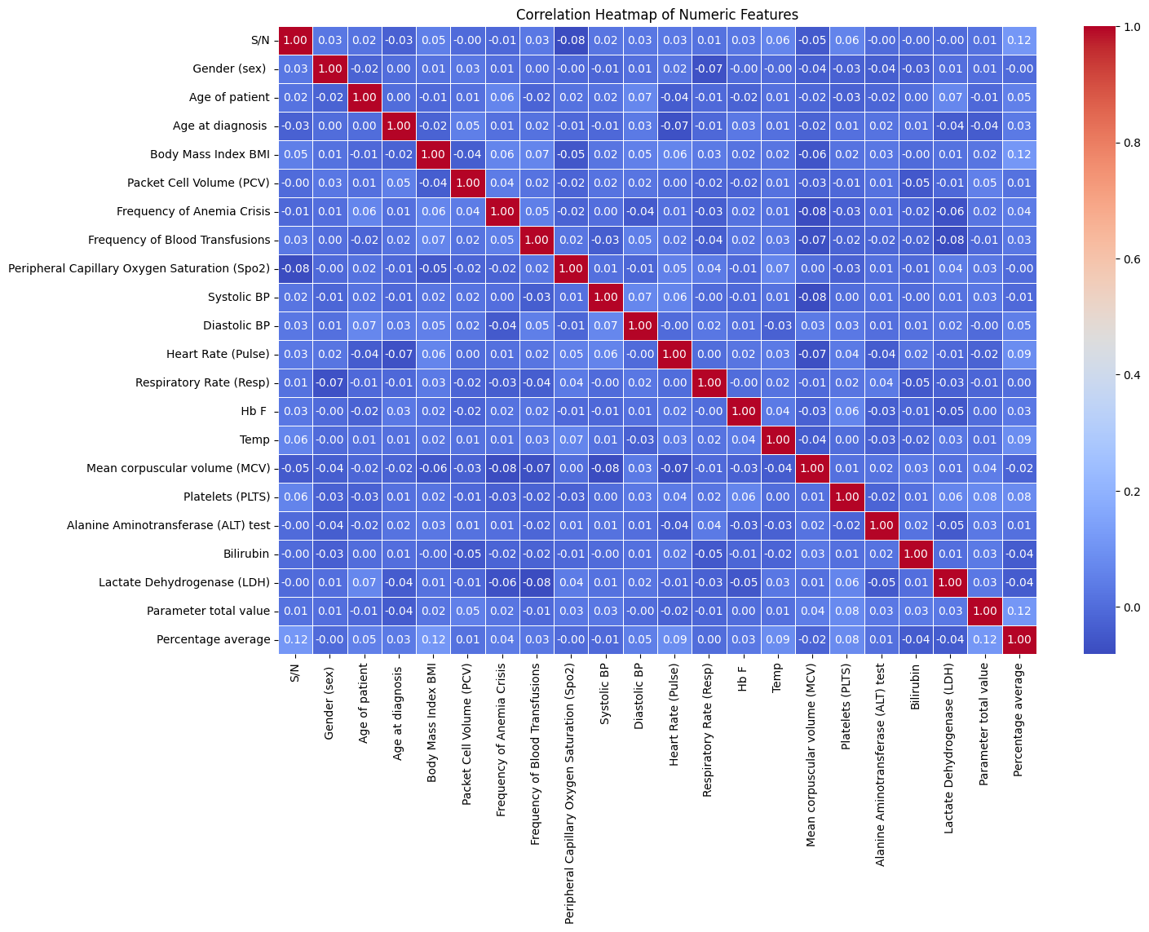
METHODOLOGY
Data Collection and Preparation
Descriptive statistics
Feature selection
Exploratory Data Analysis
Modelling and Training
Testing the models

Slide 9
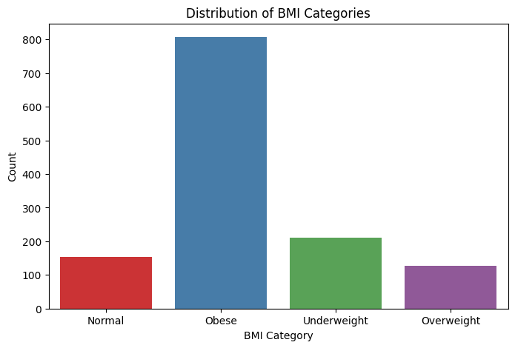
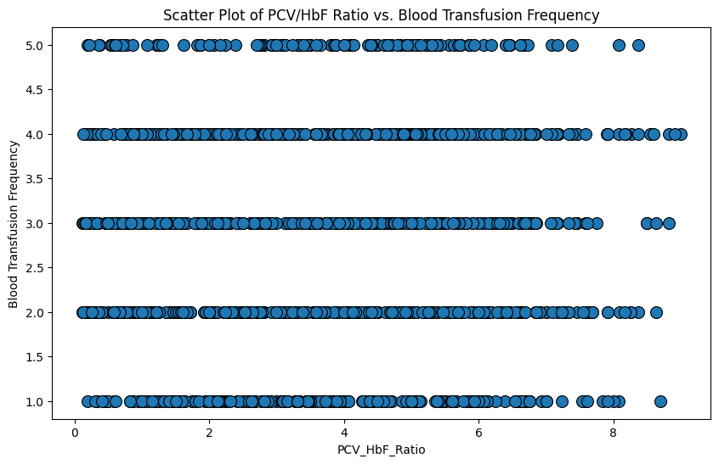
EDA Insights
EDA Insights

Slide 10
RESULTS
Decision Tree Regressor:
The R-squared value of 1.0 indicates the model perfectly fits the training data. However, this is a strong sign of overfitting..
Random Forest Regressor:
The R-squared of 0.9050 suggests a good fit between the model and the training data. The model can explain 90.5% of the variance in blood transfusion frequency based on the provided features.
The RMSE of 0.4362 indicates a moderate error in predicting blood transfusion frequency.
Gradient Boosting Regressor:
The R-squared of 0.2416 suggests a weak fit between the model and the training data. The model only explains 32.16% of the variance in blood transfusion frequency.
The RMSE of 1.0540 indicates a high error in predicting blood transfusion frequency.

Slide 11
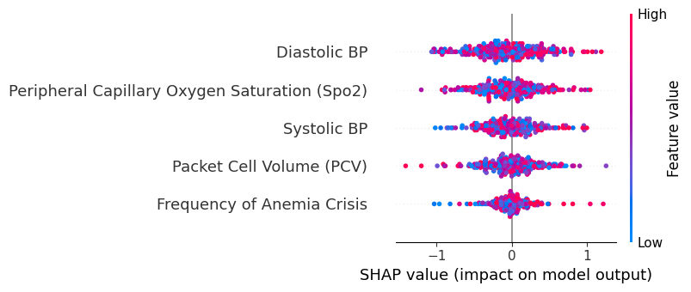
Feature importance

Slide 12
CONCLUSION AND FUTURE WORK
Additional Features:
To gain deeper insights, future models can incorporate additional factors such as genotype, comorbidities, and socioeconomic status. These features may provide a more comprehensive understanding of transfusion frequency and help identify disparities in transfusion requirements across different patient populations.
Time Series Analysis:
Including a time component (e.g., dates of transfusions), analyzing trends and seasonal patterns can yield valuable insights. This could help predict when patients are more likely to require transfusions, enabling better planning and resource allocation.
Model Deployment:
Develop and deploy a web-based or mobile application that integrates the Random Forest model to assist clinicians in predicting transfusion needs and optimizing patient care.

